Slide 1

Latinos and the Affordable Care Act:
The Importance of the
Health Insurance Marketplace
July 2013
Notes:
Good morning and thank you for being with us today. As Marco said, my name is Mayra Alvarez and it is my pleasure to be with you today to provide you with a high-level overview of the Affordable Care Act, and the new Health Insurance Marketplace, and in particular the impact on the health of the Latino community.

Slide 2
The Problem
Insurance companies could take advantage of you and turn away the 129 million Americans with pre-existing conditions.
Premiums had more than doubled over the last decade.
Tens of millions were underinsured, many had coverage but were afraid of losing it, and 50 million Americans had no insurance at all.
Latinos, like other racial and ethnic minorities, continued to lag behind in many health indicators, including prevalence of chronic illness and access to quality care.
Notes:
The first question most people have is: why did we need the health care law? The answer is that we had a health insurance market that worked very well for big insurance companies, but not so well for American families.
Insurers could pick and choose who they gave coverage to. And premiums were skyrocketing even as insurers made record profits.
As a result, tens of millions were stuck with coverage that didn’t cover critical treatments and preventive care. And many of those who had insurance didn’t understand the basics of their plan – and were afraid of losing it if their employer dropped coverage or they switched jobs or retired.
Fifty million Americans had no insurance at all. For Latinos, like other racial and ethnic minorities, continued to lag behind in many health indicators, including prevalence of chronic illness and access to quality care.
This left many Americans feeling like their health care choices were out of their hands.

Slide 3
1/3 of Uninsured are Hispanic
Source: People Without Health Insurance Coverage by Race and Hispanic Origin Using 2- and 3-Year Averages: 2008-2009 and 2010-2011. U.S. Census Bureau, Current Population Survey, 2009 to 2012 Annual Social and Economic Supplements.
Notes:
When it comes to the uninsured, you can see the populations that are hit hardest. Approximately one out of every three people who are uninsured are Latino.
And we know that this challenge is exacerbated in certain parts of the country.

Slide 4
Affordable Care Act –
Coverage Accomplishments for Latinos
913,000 Latino young adults have gained insurance through their parents’ plans
3.9 million Latinos with Medicare received a free preventive service, such as flu vaccines, diabetes screenings, and an annual wellness visit with their doctor
8.2 million Latinos who have private insurance gained improved coverage for preventive services
Approximately 10.2 million Latinos no longer have to worry about going without treatment for cancer and other chronic diseases because of lifetime dollar limits.
Notes:
And we have done a lot of work in the three plus years since the law was enacted.
This is a highlight of some of the new coverage provide through the Affordable Care Act:
Close to one million Latino young adults have gained insurance through their parents’ plans, because they law requires plans to allow children until the age of 26.
3.9 million Latinos with Medicare received a free preventive service, such as flu vaccines, diabetes screenings, and an annual wellness visit with their doctor
8.2 million Latinos who have private insurance gained improved coverage for preventive services
Approximately 10.2 million Latinos no longer have to worry about going without treatment for cancer and other chronic diseases because of lifetime dollar limits.
All of these changes help reassure Latinos that their health insurance will be there when they need it the most.
MORE INFO
6.1 million people with Medicare through 2012 received $5.7 billion in prescription drug discounts
34 million people with Medicare received a free preventive service, 71 million privately insured people gained improved coverage for preventive services
105 million Americans have had lifetime limits removed from their insurance

Slide 5
Affordable Care Act –
Cost Savings
Slowest sustained national health spending growth in 50 years
  Low growth continuing in 2012 for Medicare and Medicaid
$2.1 billion returned to consumers in 2011
  Plans must spend 80% now on healthcare
Rate increases fell from 75% in 2010 to 14% so far in 2013
$4.2 billion recovered in 2012 from anti-fraud efforts – a record high – for a total of nearly $15 billion over the last 4 years, double that of the previous 4 years
Notes:
This is a highlight of some of the cost savings accomplished by the Affordable Care Act:
Slowest sustained national health spending growth in 50 years, with low growth continuing in 2012 for Medicare and Medicaid
$2.1 billion has been returned to consumers through medical loss ratio (80 / 20 rule) rebates and rate review in 2011
Percent of double-digit rate increases fell from 75% in 2010 to 14% so far in 2013
$4.2 billion was recovered in 2012 from anti-fraud efforts – a record high – for a total of nearly $15 billion over the last 4 years, double that of the previous 4 years

Slide 6

The Health Insurance Marketplace
  The Marketplace (or Exchange)
    Place for individuals and small employers to get private health insurance options
    Can directly compare on the basis of price, benefits, quality, and other factors
  A new way to get health insurance
    Enrollment starts October 1, 2013
    Coverage begins January 2014
Notes:
So that is a bit of where we have been and now let’s talk about where we are going. This fall, we will launch the Health Insurance Marketplace.
The Marketplace is for individuals and small employers to directly compare certain competitive private health insurance options, known as Qualified Health Plans, on the basis of price, quality, and other factors. This presentation only focuses on coverage for individuals and not on small businesses.
The Marketplace, which will become fully operational by January 1, 2014, will help enhance competition in the health insurance market, improve choice of affordable health insurance, and give small businesses similar options as large businesses.
When key parts of the health care law take effect, there’ll be a new way to buy health insurance: the Health Insurance Marketplace.
Enrollment starts October 1, 2013
Coverage begins January 2014

Slide 7
3 Things to Know about the Marketplace…
1. It’s an easier way to shop for health insurance
  Simplifies the search for health insurance
  All options in one place
  One application, one time, and an individual or family can explore every qualified insurance plan in the area
2. Most people will be able to get a break on costs
  90% of people who are currently uninsured will qualify for discounted or free health insurance
3. Clear options with apples-to-apples comparisons
  All health insurance plans in the Marketplace present their price and benefit information in plain language
Notes:
1. It’s an easier way to shop for health insurance
Simplifies the search for health insurance
All options in one place
One application, one time, and an individual or family can explore every qualified insurance plan in the area
2. Most people will be able to get a break on costs
90% of people who are currently uninsured will qualify for discounted or free health insurance
3. Clear options with apples-to-apples comparisons
All health insurance plans in the Marketplace present their price and benefit information in simple terms you can understand
Helps enhance competition in the health insurance market
Increases Affordability through premium tax credits, cost sharing reductions, or public insurance programs
Ensures Quality though QHPs that must meet basic standards, including quality standards, consumer protections, and access to an adequate range of clinicians
Makes Costs Clear by providing information about prices and benefits in simple terms consumers can understand, so they don’t have to guess about costs

Slide 8
Marketplace Establishment
Each state can choose between:
  State Based Marketplace – State creates and runs its own Marketplace
  State Partnership Marketplace – State partners with Federal government to run some Marketplace functions
  Federally Facilitated Marketplace – State has a Marketplace established and operated by the Federal government – known to consumers as The Health Insurance Marketplace
Notes:
Each state can choose between:
State Based Marketplace – State creates and runs its own Marketplace
State Partnership Marketplace – State partners with Federal government to run some Marketplace functions
Federally Facilitated Marketplace – State has a Marketplace established and operated by the Federal government

Slide 9
All Qualified Health Plans Will Cover These Essential Health Benefits
Ambulatory patient services
Emergency services
Hospitalization
Maternity and newborn care
Mental health and substance use disorder services, including behavioral health treatment
Prescription drugs
Rehabilitative and habilitative services and devices
Laboratory services
Preventive and wellness services and chronic disease management
Pediatric services, including oral and vision care
Notes:
The Health Care Law provides for the establishment of an Essential Health Benefit (EHB) package that includes coverage of EHBs (as defined by the Secretary of the Department of Health and Human Services (the Secretary)). The law directs that EHBs be equal in scope to the benefits covered by a typical employer plan and cover at least the following 10 general categories:
Ambulatory patient services
Emergency services
Hospitalization
Maternity and newborn care
Mental health and substance use disorder services, including behavioral health treatment
Prescription drugs
Rehabilitative and habilitative services and devices
Laboratory services
Preventive and wellness services and chronic disease management
Pediatric services, including oral and vision care
So every plan will cover the essential services we need to get or stay healthy.

Slide 10
How Qualified Health Plans Can Vary
Some may cover additional benefits
You may have to see certain providers
The premiums, copays, coinsurance
Quality of care
Some special types of plans
  Like high-deductible plans
Notes:
Something I want to flag for you is that Qualified Health Plans in the Marketplace can vary.
For example:
Some may cover additional benefits
You may have to see certain providers
The premiums, copays, and coinsurance will vary by plan
Quality of care may vary but
All cover Essential Health Benefits
The Marketplace will let you compare, choose and enroll.
Qualified Health Plans will be available with different levels of cost sharing. A plan will offer the same package of benefits in each level. What varies is how much the plan pays, and how much you will pay (cost sharing). Out-of-pocket costs include deductibles, which is the amount you pay for your covered health care services before your plan starts to pay. You also pay copayments. For instance, you may have to pay $20 each time you see your doctor. And you may also have to pay coinsurance for certain services. For instance, if the coinsurance is 30% and the covered service cost $100, you would pay $30 and the plan would pay $70.

Slide 11
Small Business Health Options Program
(SHOP)
SHOP is a Marketplace for small businesses and their employees (fewer than 100 employees)
  Employer must offer coverage to all full-time employees
  Sole proprietors may buy through the Marketplace rather than the SHOP
Eligible employers can:
  Have exclusive access to a tax credit
  Define how much they’ll contribute toward their employees’ coverage
Notes:
The Marketplace is not only for individuals and families who buy their own insurance but also for small businesses.
The SHOP or Small Business Health Options Program is a Marketplace for small businesses and their employees (fewer than 100 employees). The Marketplace will give small businesses the same advantages of large businesses.
States may limit participation to those with 50 or fewer employees for the first 2 years
Employer will access the SHOP where its principle business office is located
Employer must offer coverage to all full-time employees
Sole proprietors may buy through the Marketplace rather than the SHOP
By participating in the SHOP, eligible employers can benefit from new protections that help them get real value for consumer’s premium dollars. In addition, employers will define how much they’ll contribute toward their employees’ coverage and have exclusive access to a small business tax credit. This tax credit has been available to small businesses since 2010.

Slide 12
Eligibility and Enrollment
Marketplace initial open enrollment period starts October 1, 2013 and ends March 31, 2014
Marketplace eligibility requires consumers to
  Live in its service area, and
  Be a U.S. citizen or national, or
  Be a non-citizen who is lawfully present in the U.S. for the entire period for which enrollment is sought
  Not be incarcerated
Notes:
For the first, the Marketplace initial open enrollment period starts October 1, 2013 and ends March 31, 2014.
In order to be eligible to get coverage through the Marketplace, consumers must:
Live in its service area, and
Be a U.S. citizen or national, or
Be a non-citizen who is lawfully present in the U.S. for the entire period for which enrollment is sought
Not be incarcerated

Slide 13
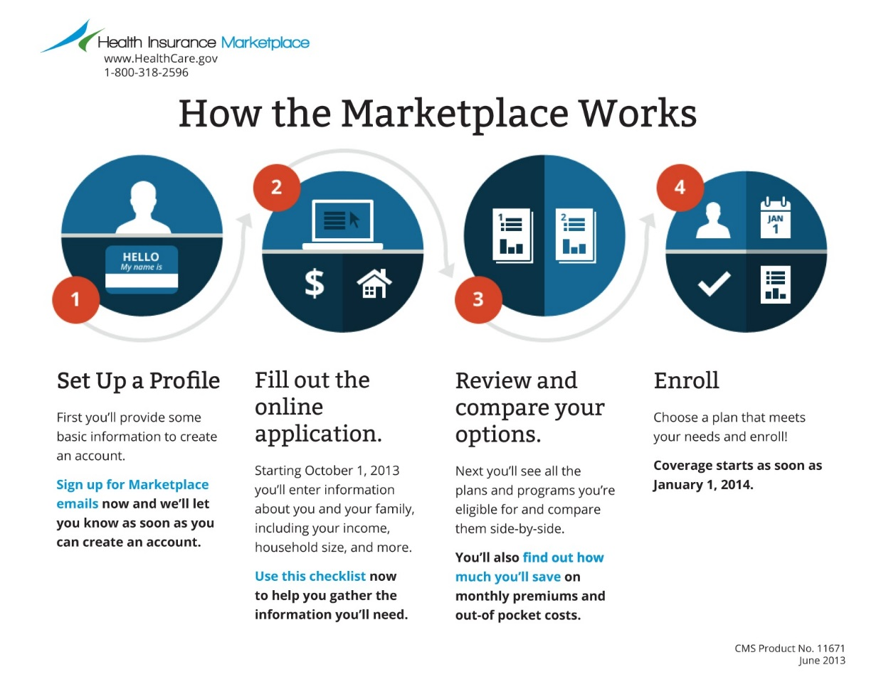
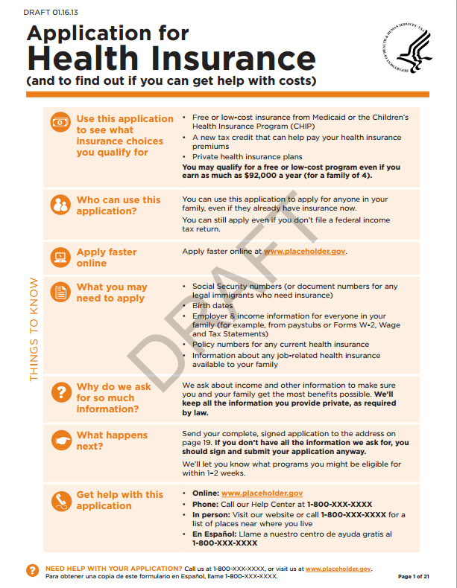
Applying for Coverage in the Marketplace
Online Enrollment
HHS Paper Application
Notes:
The opportunity to get coverage will be simplified. Beginning on October 1, 2013, the new Health Insurance Marketplace as well as and State Medicaid and Children’s Health Insurance Program (CHIP) agencies will use a single, streamlined application to determine eligibility for enrollment
into Qualified Health Plans (QHPs) and for insurance affordability programs including advance payments of the premium tax credit (APTCs), cost-sharing reductions (CSRs), Medicaid, and CHIP.
This will be a seamless process for consumers. Let’s talk a bit more about these opportunities for coverage.

Slide 14
Medicaid Expansion
States have the option to expand Medicaid eligibility to adults ages 19 – 64 with incomes up to 133% of the Federal Poverty Level (FPL) ($15,282/year for an individual, $31,322/year for a family of 4)
  100% federal funding for newly Medicaid eligible
  States have no deadline to decide if they are going to expand
One streamlined application for Medicaid or private health plans
Shifts to simplified way of calculating income to determine Medicaid/CHIP eligibility
  Known as Modified Adjusted Gross Income (MAGI)
Notes:
Because of the Affordable Care Act, states have the option to expand Medicaid eligibility to adults ages 19 – 64 with incomes up to 133% of the Federal Poverty Level (FPL) ($15,282/year for an individual, $31,322/year for a family of 4)
For the first three years, states will received 100% federal funding for the cost of the newly Medicaid eligible and after that, the federal government will support at least 90% of the cost.
States have no deadline to decide if they are going to expand
Again, there will be one streamlined application for Medicaid or private health plans.
In addition, there is a new simplified way of calculating income to determine Medicaid/CHIP eligibility
Known as Modified Adjusted Gross Income (MAGI)

Slide 15

Help to Pay the Cost of Insurance Coverage in the Marketplace
Based on family income and size
  Premium discount
    Family of four with annual income $23,550* – $94,200* or less
    And not eligible for certain other insurance coverage like Medicaid
  Lower cost-sharing (like copays)
    Family of 4 with annual income $58,875* or less (some other restrictions)
*2013 amounts
Notes:
For those individuals that will not qualify for Medicaid and who need some financial help paying for insurance coverage, the new premium discount available through the Marketplace lets you reduce your costs right away.
People who qualify can take the premium discount in the form of advance payments to lower their monthly Marketplace health plan premiums starting in 2014, which can help make insurance more affordable. A payment will go directly to the insurance company. When you apply, you will provide your household income, identification to show that you are in the U.S. legally and other information. The premium discount is generally available to individuals and families with incomes between 100% and 400% of the Federal Poverty Level ($23,550 – $94,200 for a family of four in 2013) who do not have access to certain other types of minimum essential coverage, which will make coverage much more affordable for the middle class.
To be eligible for cost-sharing reductions, you must have a household income that is less than or equal to 250% of the Federal Poverty Level (FPL) which is $58,875 annually for a family of four in 2013. In addition, you must also meet the requirements to enroll in a health plan through the Marketplace and receive the premium discount; and enroll in a silver-level plan through the Marketplace.

Slide 16
Catastrophic Plans
Who is eligible?
  Young adults under 30 years of age
  Those who can not afford coverage and obtain a hardship waiver from the Marketplace
What is catastrophic coverage?
  Plans with high-deductibles and lower premiums
  Includes coverage of 3 primary care visits and preventive services with no out-of-pocket costs
  Protects consumers from high out-of-pocket costs
Notes:
The Marketplace will also have additional affordable options for coverage. These plans are called catastrophic plans.
Who is eligible
Young adults under 30 years of age
Those who can not afford coverage and obtain a hardship waiver from the Marketplace
What is catastrophic coverage?
Plans with high-deductibles and lower premiums
Includes coverage of 3 primary care visits and preventive services with no out-of-pocket costs
Protects consumers from high out-of-pocket costs

Slide 17
Payments with Your Tax Returns
In 2014
  If you don’t have a certain level of health coverage (employer coverage, Medicare, Medicaid, CHIP, TRICARE, certain VA coverage, an individual policy, or a plan in the Marketplace) you may have to make a payment with your tax return
    Starting when you file your 2014 Federal tax return in 2015
  Some people may qualify for an exemption
Notes:
If you don’t have health coverage, you may have to make a payment when you file your 2014 Federal income tax return in 2015, and thereafter. The IRS routinely works with taxpayers who owe amounts they cannot afford to pay. The law prohibits the IRS from using liens or levies to collect any payment you owe related to the individual responsibility provision, if you, your spouse or a dependent included on your tax return does not have minimum essential coverage.
It is also important to note that there are a variety of reasons you may get an exemption from the payment. For example, for reasons of religious conscience; if you are a member of a recognized health care sharing ministry; a member of a Federally recognized Indian tribe; you have no tax filing requirement (household income below minimum threshold); if you have a short coverage gap (less than 3 consecutive months); you suffered a hardship; you have unaffordable coverage options (minimum amount you must pay for premiums is more than 8% of your household income), you are incarcerated; or if you are not lawfully present (neither a U.S. citizen, a U.S. national, nor an alien lawfully present in the U.S.).
The payment will be the greater of the following amounts:
The flat dollar amount of $95 in 2014, $325 in 2015, and $695 in 2016. Thereafter increases per cost of living adjustment.
The percentage of income in excess of the household income over the Federal income tax return filing threshold multiplied by 1% in 2014, 2% in 2015, and 2.5% in 2016 and after.

Slide 18
Application and Eligibility
Enroll
(Marketplace)
Submit single, streamlined application to the Marketplace
Verify and determine eligibility
Eligible for Marketplace or
Medicaid/CHIP
Enroll
(Medicaid/CHIP)
Online
Phone
Mail
In Person
Supported by Data Services Hub
Notes:
So, let’s recap the process.
You will submit a single, streamlined application to the Marketplace. You can apply online, by phone, via mail or in person.
Then your application is verified (supported by a data services Hub between SSA, the IRS, and Homeland Security) and your eligibility is determined.
You may be determined eligible for the Marketplace, Medicaid, or the Children’s Health Insurance Program (CHIP).
You then enroll in the program you are eligible for.

Slide 19




How to Apply
Easy
Convenient
Streamlined
By Mail
Online
By Phone
In Person
Notes:
Once again, you can apply online, by phone, by mail or in person. The application process has been streamlined.

Slide 20

Assistance – It’s Available If You Need It
Help will be available in the Marketplace
  Toll-free call center - 24/7
    150 languages
  Website chat 24/7 (English and Spanish)
  Help in-person
    Navigators
    Other trained enrollment assisters
      Local Community Health Centers, libraries, hospitals and other locations in local communities
    Agents and brokers
Notes:
If you have questions or need help applying, there are several resources that will be available, including a toll-free call center and website with plan comparison tools. There are also several programs to help you through the process of enrolling and using health insurance, including the Navigator program.
Community-based organizations, agents and brokers, and other third party assistors, such as certified application counselors, will also play a large role in helping people apply for health insurance coverage. The final rule lays out ways for agents and brokers to help consumers and small businesses enroll through the Marketplace if the state so chooses.
MORE INFO
It is important to note that some of the assistance resources (Marketplace call centers and websites, and Navigators) will be unbiased and impartial, while others (agents and brokers, and issuer web sites and call centers), will not.
For information about enrolling in Medicaid or the Children’s Health Insurance Program (CHIP) now, check with your State Medical Assistance (Medicaid) Office. Call 1-800-MEDICARE (1-800-633-4227) to get their phone number. TTY users should call 1-877-486-2048. Or, visit www.medicare.gov/contacts and search for your state Medicaid office’s contact information.
NOTE: Navigators cannot receive compensation from health insurance issuers related to enrollment.

Slide 21

www.HealthCare.gov
Now - Sign up for Email and Text Alerts and Get Ready
Starting October 1, 2013, you will be able to apply through this site
Also available in Spanish: CuidadoDeSalud.gov
Notes:
If you have friends or family who don’t have, or can’t afford health insurance, go to www.healthcare.gov for information about the new Health Insurance Marketplace. Through one streamlined application process you can learn about the programs you qualify for.
You can use the website to:
Find out about available insurance options
Get help using your insurance
Learn about the new health care law

Slide 22
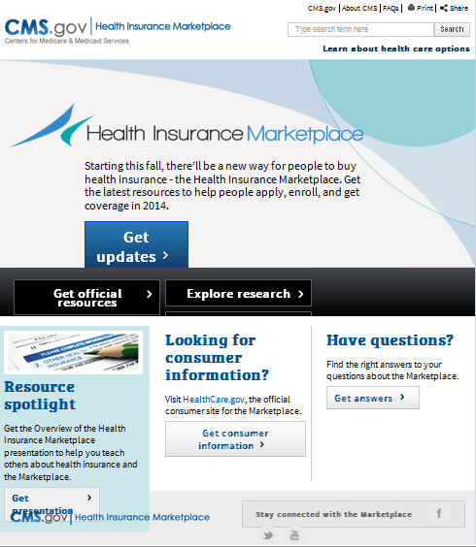
Marketplace.cms.gov
Get the latest resources to help people apply, enroll, and get coverage in 2014
Notes:
For our partners, community organizations that want to learn more about how to help, you can get up to date information to help you counsel people who may benefit from the Heath Insurance Marketplace at Marketplace.cms.gov. There is access to consumer materials, training materials, research and more. You can sign up for updates as well.

Slide 23
Key Points to Remember
The Marketplace is a new way to find and buy health insurance
Individuals and small businesses can shop for health insurance that fits their budget
States have flexibility to establish their own Marketplace
There is financial help for working families and other people with limited income
There is assistance available to help consumers get the best coverage for their needs
Notes:
So, as a wrap up, some key points to remember.
The Marketplace is a new way to find and buy health insurance
Individuals and small businesses can shop for health insurance that fits their budget
States have flexibility to establish their own Marketplace
There is financial help for working families and other people with limited income
There is assistance available to help consumers get the best coverage for their needs

Slide 24
Want more information about the Marketplace?
Stay Connected
  Sign up to get email and text alerts at signup.healthcare.gov
  Updates and resources for partner organizations are available at Marketplace.cms.gov
  Twitter: @HealthCareGov, @CuidadoDeSalud
  Facebook: facebook.com/Healthcare.gov, facebook.com/CuidadoDeSaludgov
Notes:
Need more information about the Health Insurance Marketplace?
Sign up to get email and text alerts at signup.healthcare.gov
Updates and resources for partner organizations are available at Marketplace.cms.gov/
Like us on Facebook and follow us on Twitter!

